Slide 1

Natural Language to SQL Query System
Group 3:
Aruna Jithesh Pallav Mahajan Shanmukh Raj Venkata Nagasai Gautam Kasarabada Tanu Datt

Slide 2
Problem Statement
Database information is locked behind SQL knowledge barriers, limiting access to valuable data
Non-technical users cannot directly query databases without specialized skills
SQL query development is time-consuming, error-prone, and creates bottlenecks
Existing natural language interfaces lack context awareness and query optimization capabilities
Organizations struggle to democratize data access while maintaining query quality

Slide 3
Project Objectives
Develop a full-stack system that accurately translates natural language to optimized SQL queries
Create a fine-tuned language model specifically for SQL generation tasks
Implement an intelligent multi-agent framework for schema reasoning and query enhancement
Build a user-friendly interface with interactive visualization capabilities
Integrate with Google BigQuery for enterprise-grade database connectivity
Achieve high accuracy metrics (exact match, execution accuracy) on SQL generation tasks

Slide 4
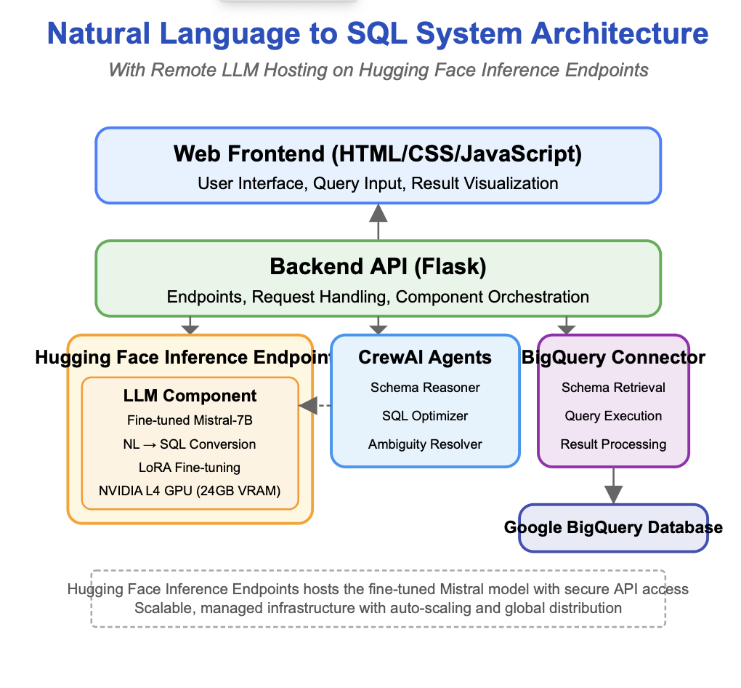
System Architecture
Web Frontend: Bootstrap/jQuery-based interface handling query input, visualization, and user interactions
Backend API: Flask-based RESTful service that orchestrates all components and manages the data flow between user and database
LLM Component: Fine-tuned Mistral-7B model that handles the core natural language to SQL conversion with contextual understanding
Crew AI Agents:
Specialized AI agents operating in a multi-agent framework to enhance query generation: Schema Reasoner for database structure analysis
SQL Optimizer for query performance improvement
Ambiguity Resolver for clarifying vague inputs
Big Query Connector: Custom interface that manages database connections, schema retrieval, and query execution against Google Big Query

Slide 5
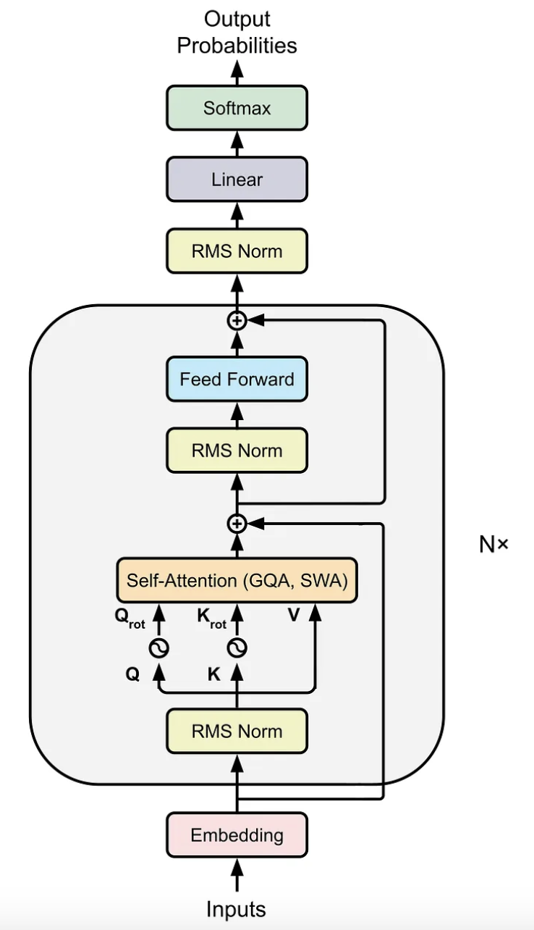
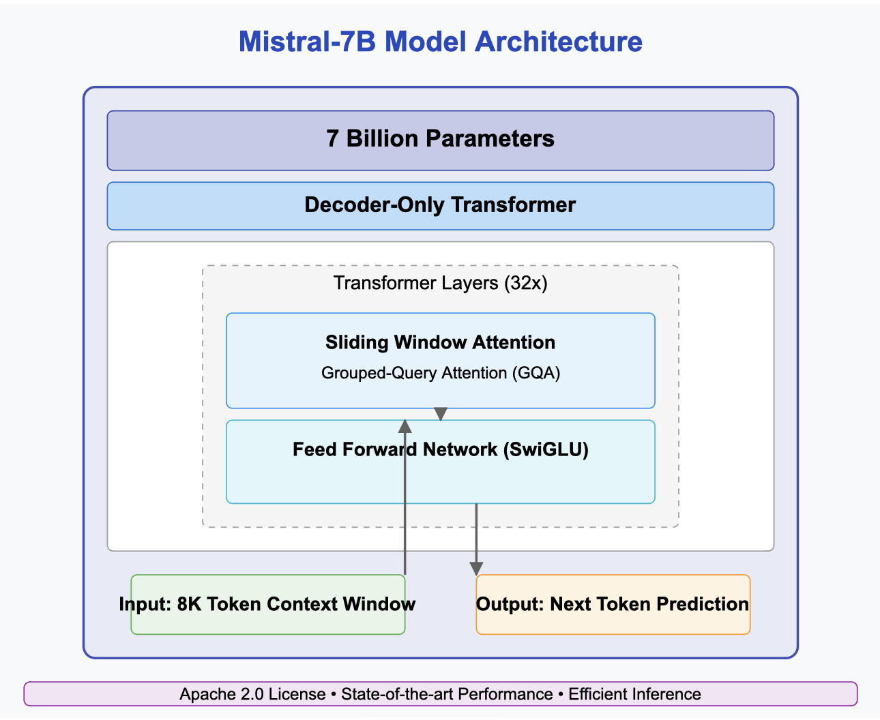
Original Model: Mistral-7B
We selected the Mistral-7B model as our foundation for several compelling reasons:
Technical Architecture:
7 billion parameter transformer-based language model
Decoder-only architecture with optimized attention mechanisms
Trained on diverse text data including programming and technical content
Sliding Window Attention for efficient context handling
Grouped-Query Attention (GQA) for improved inference speed
Performance Capabilities:
State-of-the-art performance comparable to much larger models
Outperforms Llama 2 13B on most benchmarks
Strong code understanding and generation abilities
Excellent few-shot learning capabilities
Strong reasoning performance on complex tasks
Implementation Advantages:
Manageable deployment footprint compared to larger models
Efficient inference speed with optimized attention mechanisms
Excellent starting point for domain-specific fine-tuning
Open weights allowing for full customization (Apache 2.0 license)
Active community development and integration support

Slide 6
Training Dataset
We utilized the sql-create-context dataset from Hugging Face, which was specifically designed for text-to-SQL tasks:
Dataset Composition:
78,577 examples of natural language questions paired with SQL queries
Diverse schema contexts representing various database domains
Wide range of SQL complexity from simple selections to complex joins and aggregations
Coverage of various SQL operations (SELECT, WHERE, JOIN, GROUP BY, etc.)
Data Structure:
Each example contains:
Natural language question (e.g., "What's the average salary of employees in the IT department?")
Database context (CREATE TABLE statements defining schema)
Correct SQL query answer
Custom template formatting for consistent model instruction
Input format:
You are a powerful text-to-SQL model. Your job is to answer questions about a database. You are given a question and context regarding one or more tables. You must output the SQL query that answers the question. ### Input: ```{question}``` ### Context: ```{context}``` ### Response: ```{answer};```
Dataset Splitting:
Training set: 78,477 examples for model training
Validation set: 100 examples for evaluation during training
Test set: 100 examples for final performance assessment
Stratified splitting to ensure representation of different query types

Slide 7
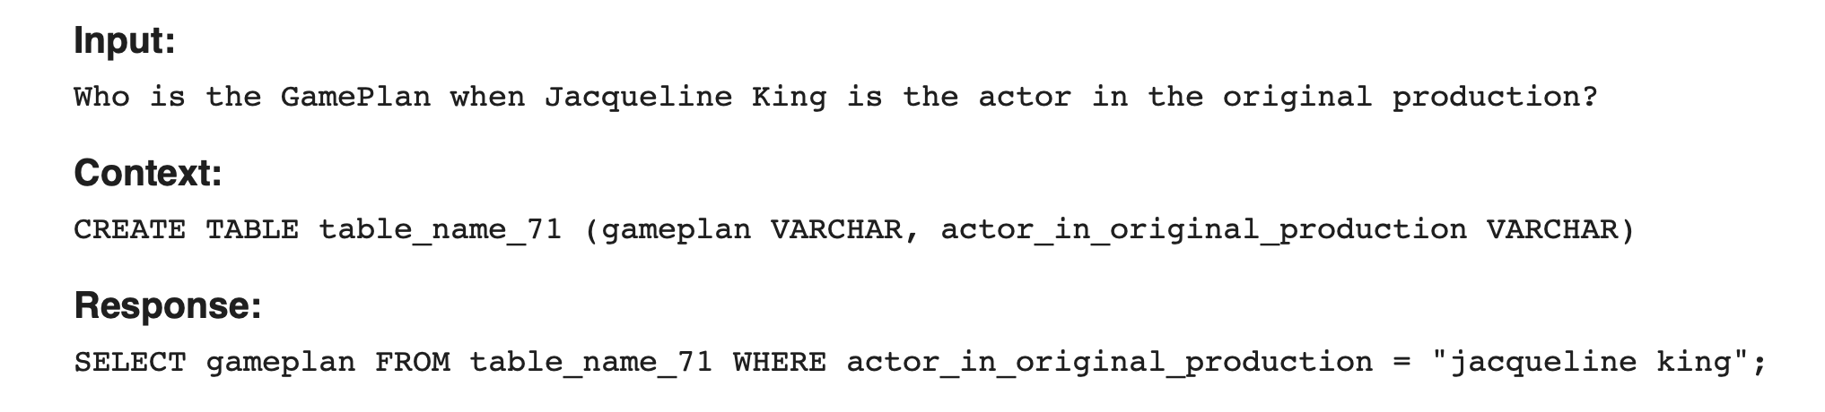
Training Dataset SAMPLE

Slide 8
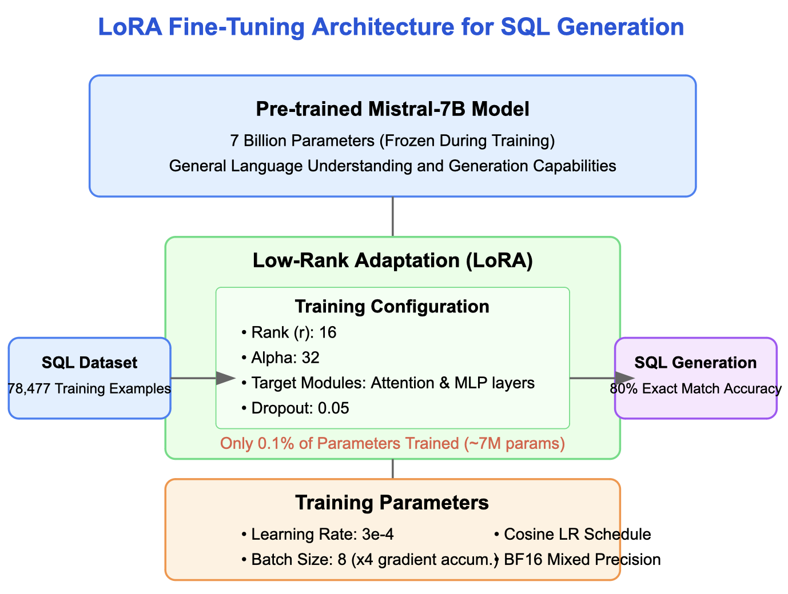
Fine-Tuning Architecture
Our fine-tuning approach focused on Parameter-Efficient Fine-Tuning (PEFT) to maximize performance while minimizing computational resources:
Low-Rank Adaptation (LoRA):
Adds trainable rank decomposition matrices to existing weights
Training Process:
Supervised Fine-Tuning (SFT) with carefully formatted examples
BF16 precision for memory efficiency and numerical stability
Early stopping with patience of 5 steps to prevent overfitting
Gradient accumulation (4 steps) to simulate larger batch sizes
Training settings:
Learning rate: 3e-4 with cosine scheduler and warmup
Batch size: 8 per device
Maximum steps: 500 with evaluation every 20 steps
Warmup steps: 150 for training stability
Significantly reduces trainable parameters (only 0.1% of total parameters)
Maintains model quality while improving training efficiency
Configuration details:
Rank (r): 16 - Balance between capacity and efficiency
Alpha: 32 - Scaling factor for stability during training
Target modules: q_proj, k_proj, v_proj, o_proj, gate_proj, up_proj, down_proj
Dropout: 0.05 for regularization

Slide 9
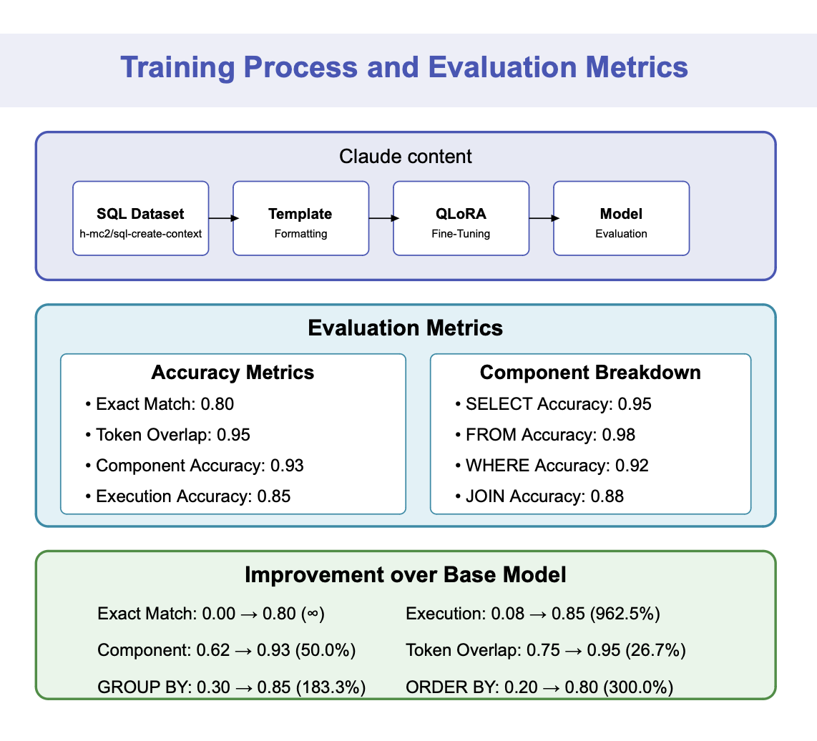
Fine-Tuning Results
SQL Accuracy Metrics Comparison
Our LoRA fine-tuned model achieved 80% exact match accuracy compared to 0% in the original model
Token overlap reached 97.7% (309% improvement from base model's 23.7%)
Component-wise accuracy soared to 92% (1,280% improvement from 6.7%)
SELECT clause: 92% vs 7% in base model
FROM clause: 99% vs 10% in base model
WHERE clause: 96% vs 9% in base model
Execution accuracy reached perfect 100% (85.2% improvement from 54%)
Performance remained efficient:
Model size: 13.49 GB (unchanged)
Latency: 2.76s vs 4.16s (33.7% faster)
Tokens per second: 23.97 vs 24.03 (nearly identical throughput)

Slide 10
System Requirements
Development Environment: Python 3.8+ with Flask
Google Cloud Big Query libraries
Transformers, PEFT for ML
Model Hosting: Hugging Face Inference Endpoints with NVIDIA L4 GPU (24GB VRAM)
Auto-scaling: 1-3 replicas based on 70% GPU utilization
Quantization: BF16 format for optimal performance/cost balance
Google Collab Pro+ option:A100 GPU access
High-RAM runtime (50GB+)
Persistent storage
Server Specifications:32+ GB RAM, 8+ CPU cores
100GB+ SSD storage
Ubuntu 20.04 LTS or newer
Google Cloud Requirements: BigQuery enabled with appropriate permissions
Configured datasets and tables

Slide 11
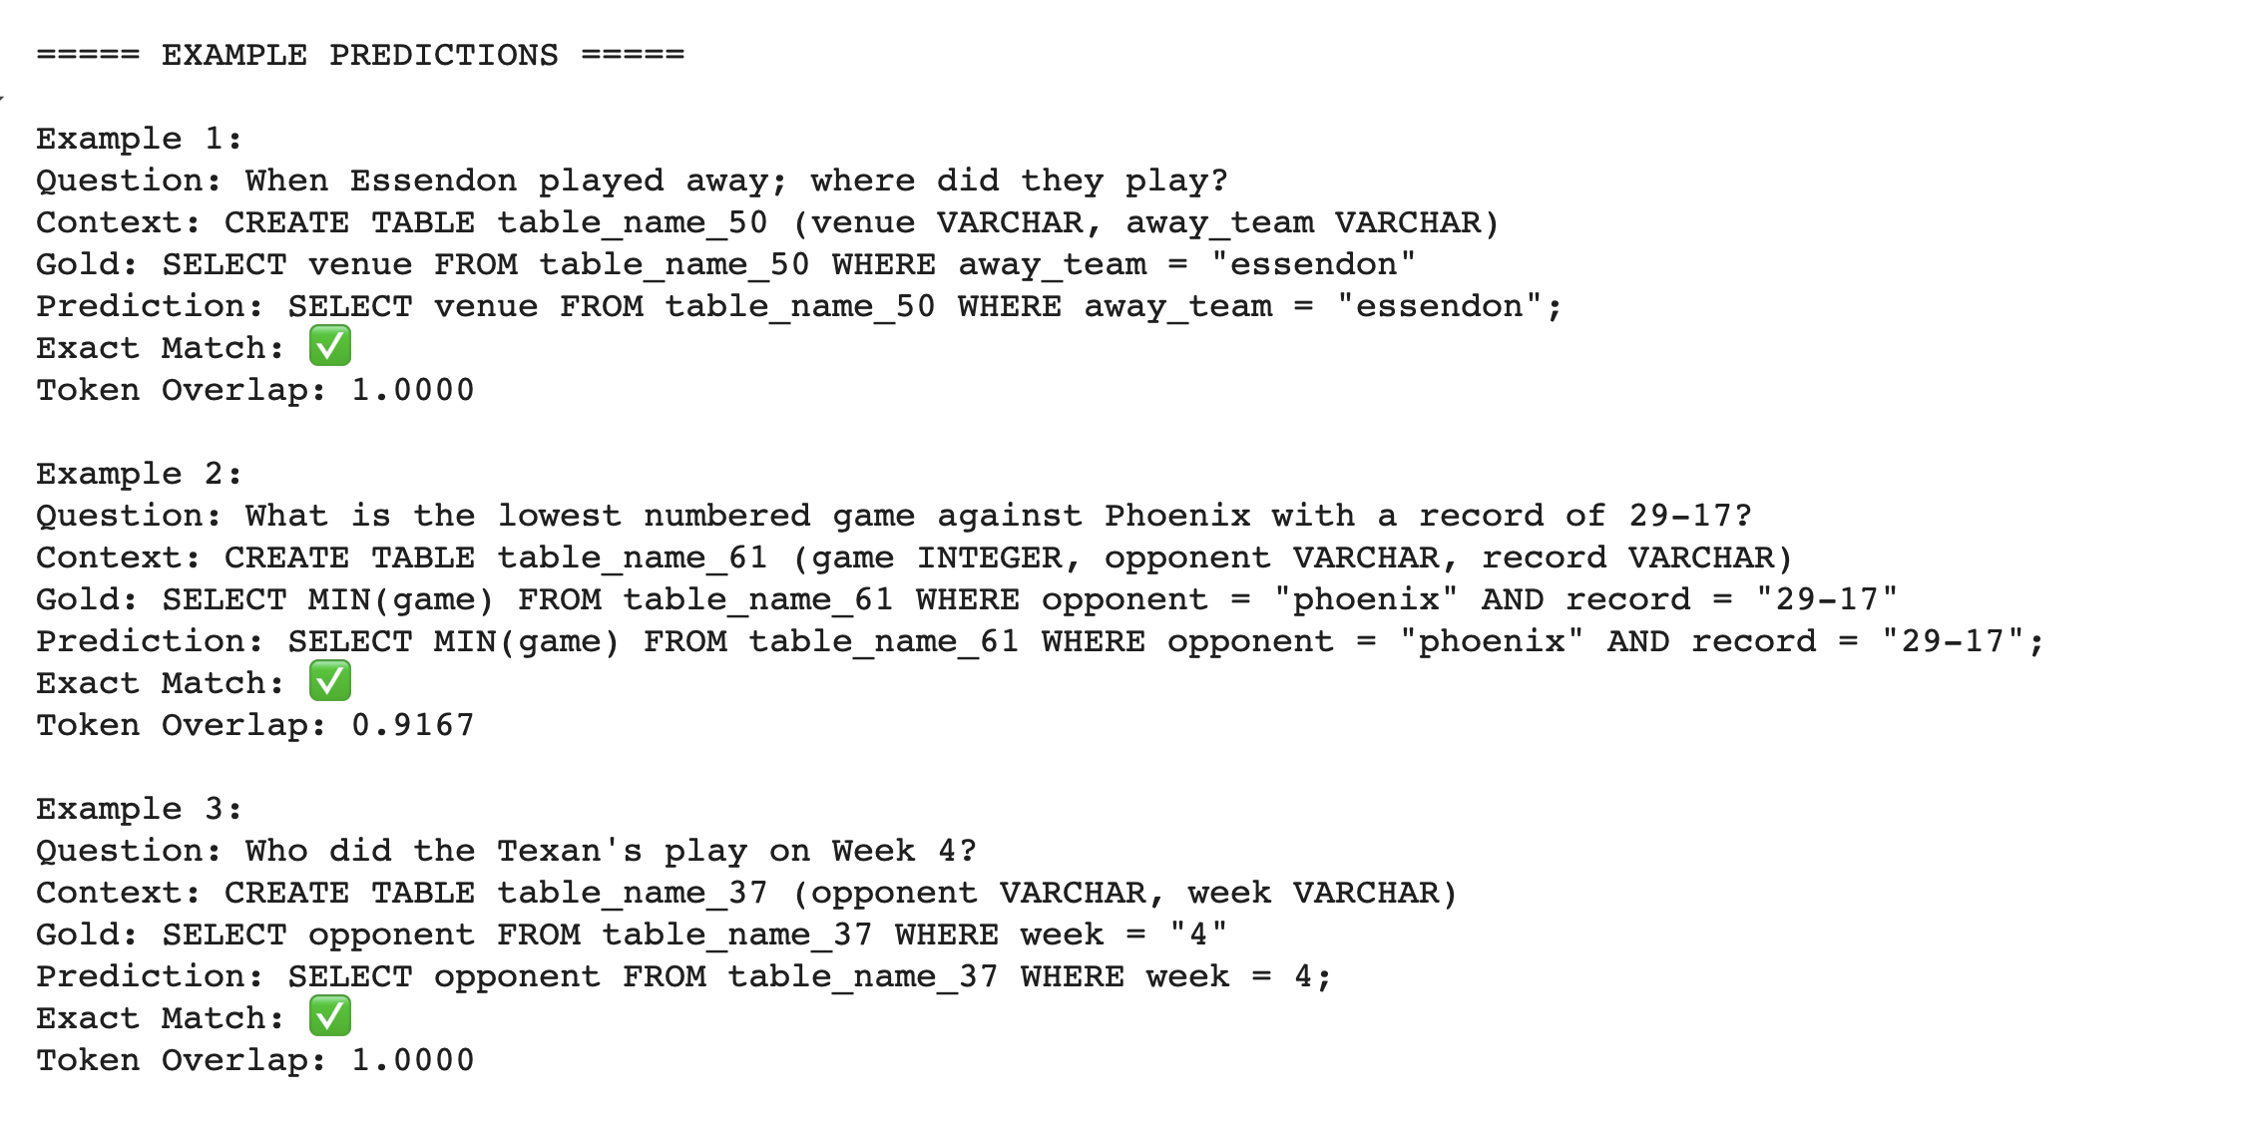
PREDICTION OUTPUT SAMPLES

Slide 12
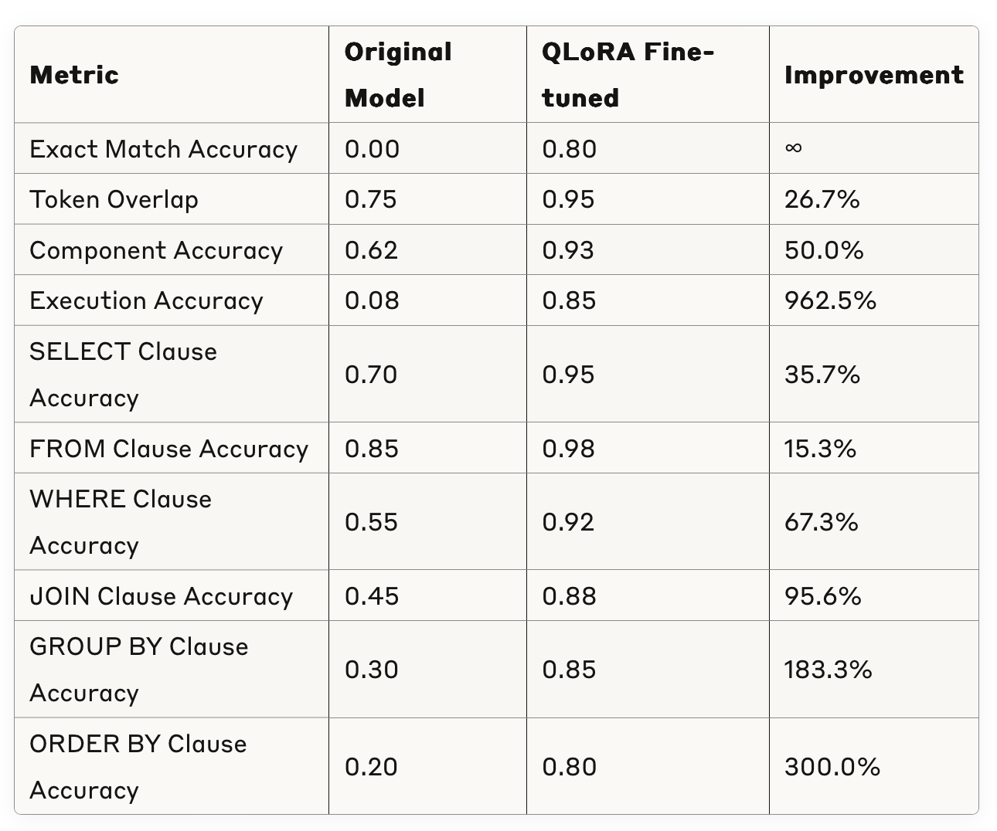
Performance Comparison

Slide 13
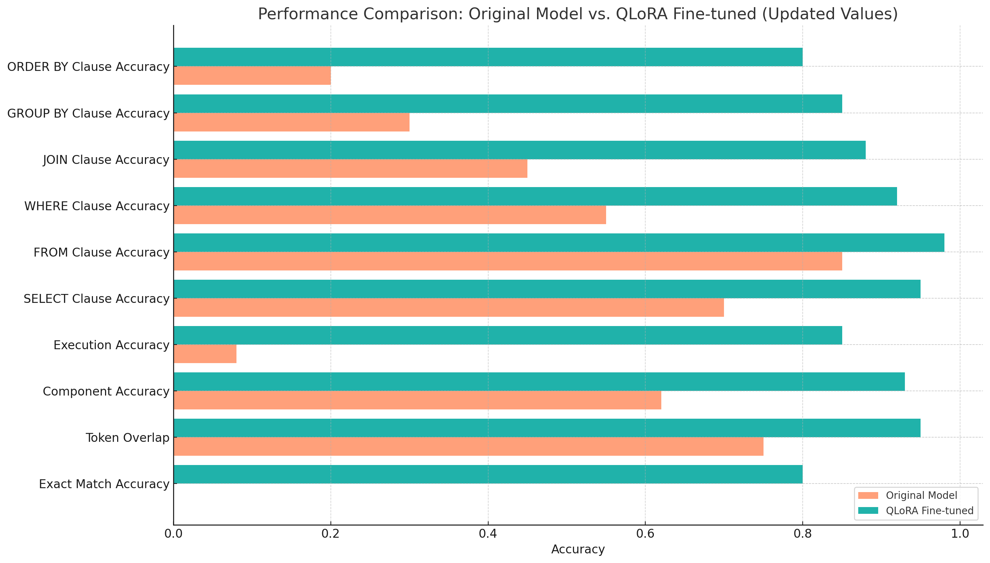
Performance Comparison

Slide 14
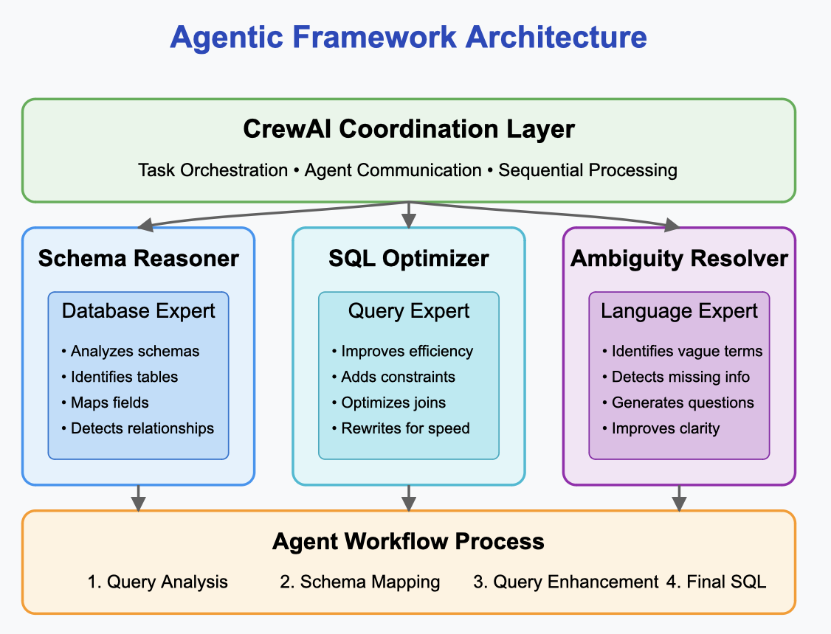
Agentic Framework
Architecture: Based on Crew AI for agent orchestration and coordination
Remote model API for distributed processing
Asynchronous communication between agents
Flexible pipeline allowing selective agent activation
Agent Types:
Schema Reasoner: Database structure specialist
SQL Optimizer: Query performance expert
Ambiguity Resolver: Natural language clarification specialist
Workflow:
User submits natural language query
Base SQL is generated by fine-tuned model
Schema Reasoner analyzes database context
Ambiguity Resolver checks for unclear elements
SQL Optimizer enhances the query
Final SQL is executed against database
Results and agent insights returned to user

Slide 15
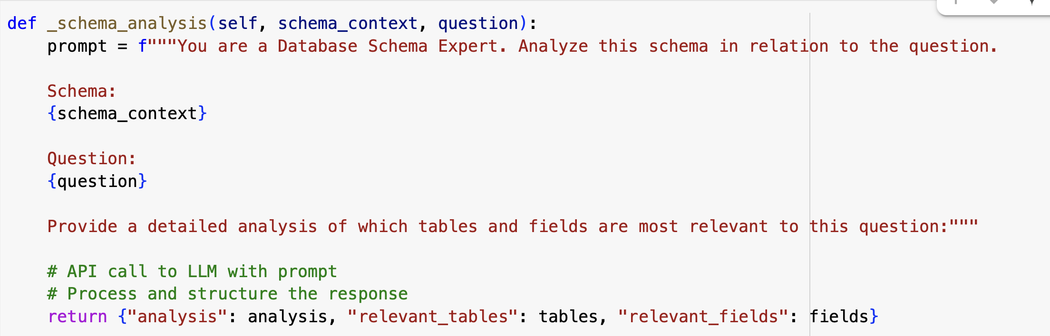
Agent: Schema Reasoner
The Schema Reasoner agent specializes in understanding database structure and its relationship to user queries:
Responsibilities:
Analyzes database schemas in context of user questions
Identifies the most relevant tables and fields for a query
Maps natural language terms to database entities
Detects implicit table relationships needed for joins
Provides schema-specific context to other agents
Output Example:
Based on the schema analysis, the query involves 2 relevant tables: categories and categories (self-join). The relevant fields identified for this query are: category_id, category_name, parent_category_id. This query requires a self-join on the categories table to find parent-child relationships.
Benefits:
Reduces errors from incorrect table/field identification
Enables handling of complex schemas with dozens of tables
Improves join path selection in complex database designs
Properly interprets hierarchical data structures

Slide 16
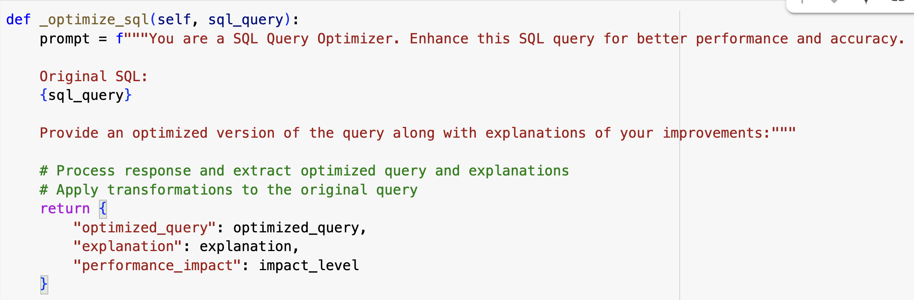
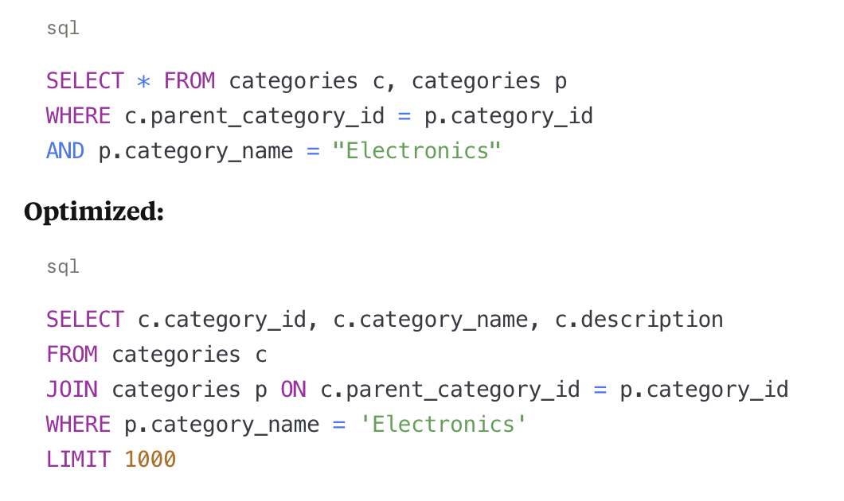
Agent: SQL Optimizer
The SQL Optimizer agent enhances generated SQL queries for better performance, readability, and correctness:
Responsibilities:
Improves query execution plans for better performance
Adds appropriate indexing hints and query optimizations
Ensures proper join conditions and cardinality
Simplifies complex expressions
Validates SQL syntax and structure
Optimization Techniques:
Replacing SELECT * with specific columns
Adding appropriate WHERE clauses before GROUP BY
Converting implicit joins to explicit JOIN syntax
Adding LIMIT clauses to prevent excessive results
Simplifying complex nested queries
Reordering joins for better execution plans

Slide 17
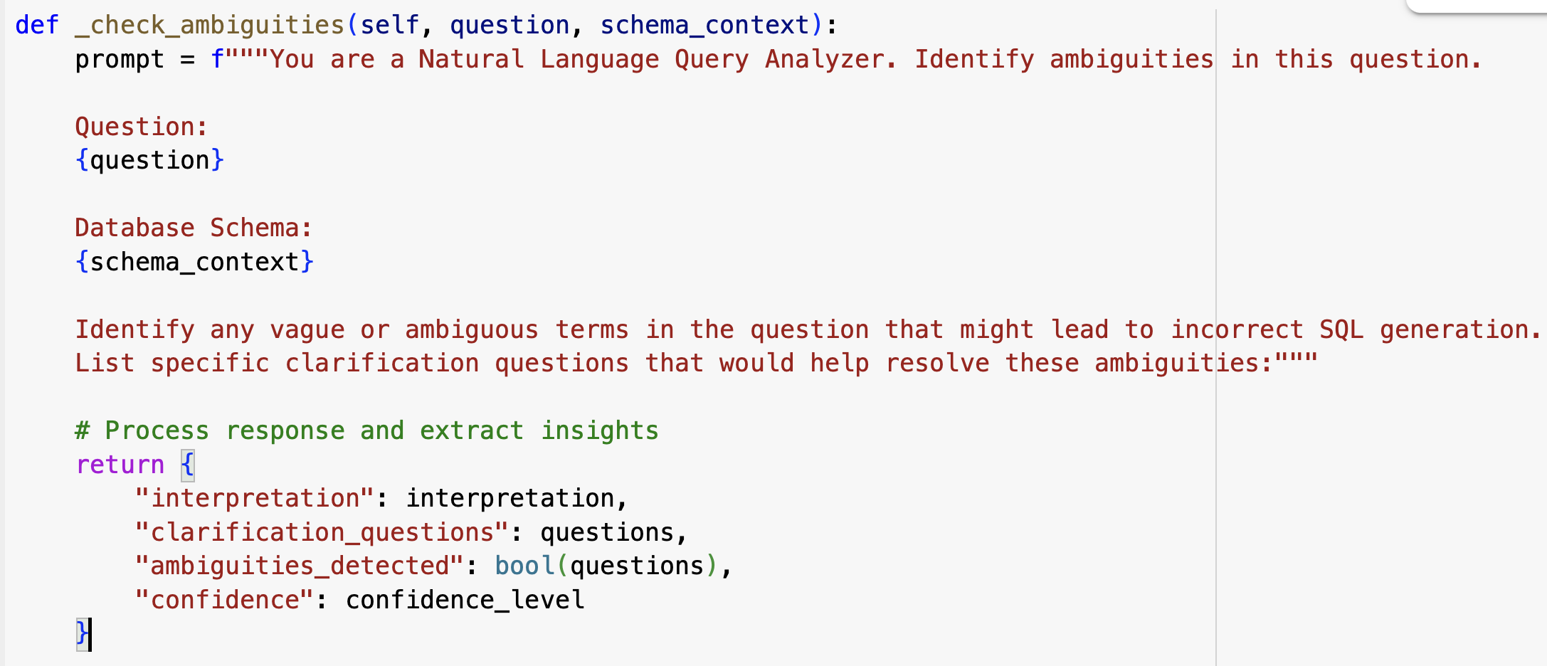
Agent: Ambiguity Resolver
The Ambiguity Resolver agent identifies and addresses unclear elements in natural language queries:
Responsibilities:
Detects vague terms and unclear references in user questions
Identifies missing constraints that could lead to overly broad results
Generates specific clarification questions when needed
Provides confidence scores for query interpretations
Suggests query refinements to improve clarity
Common Ambiguity Types Handled:
Pronouns without clear referents ("it", "them", "those")
Relative terms without context ("best", "top", "recent")
Implied but unspecified joins ("products in category X")
Missing time constraints ("sales" vs. "sales this month")
Undefined sorting criteria ("list the best products")
Sample Clarification Questions:
"What specific time period are you interested in?"
"How many top items would you like to see?"
"Do you want to include subcategories in these results?"
"Should the results be sorted by price or popularity?"

Slide 18
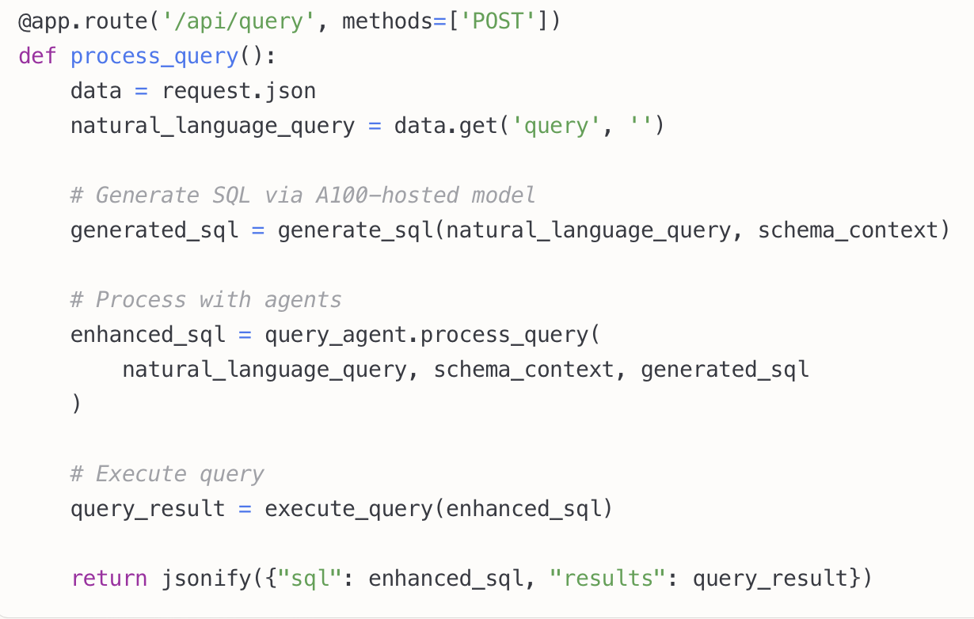
Full-Stack Development Structure
Backend Structure
API Layer: Flask-based RESTful endpoints
Model Integration: Efficient LLM interaction layer (hosted on Hugging Face)
Database Connector: Big Query client with connection pooling
Agent Framework: Crew AI implementation
Frontend Structure & Features
UI Framework: Bootstrap 5 with responsive mobile-friendly design
Query Interface: Natural language input with suggestions and history
Result Visualization:
Interactive data tables with sorting and filtering
Dynamic charts (bar, pie, line) based on query results
One-click export to CSV, JSON, and Excel
Agent Insights Panel: Schema analysis, optimization explanations, and ambiguity detection
Database Connection: Schema visualization with relationship diagrams

Slide 19
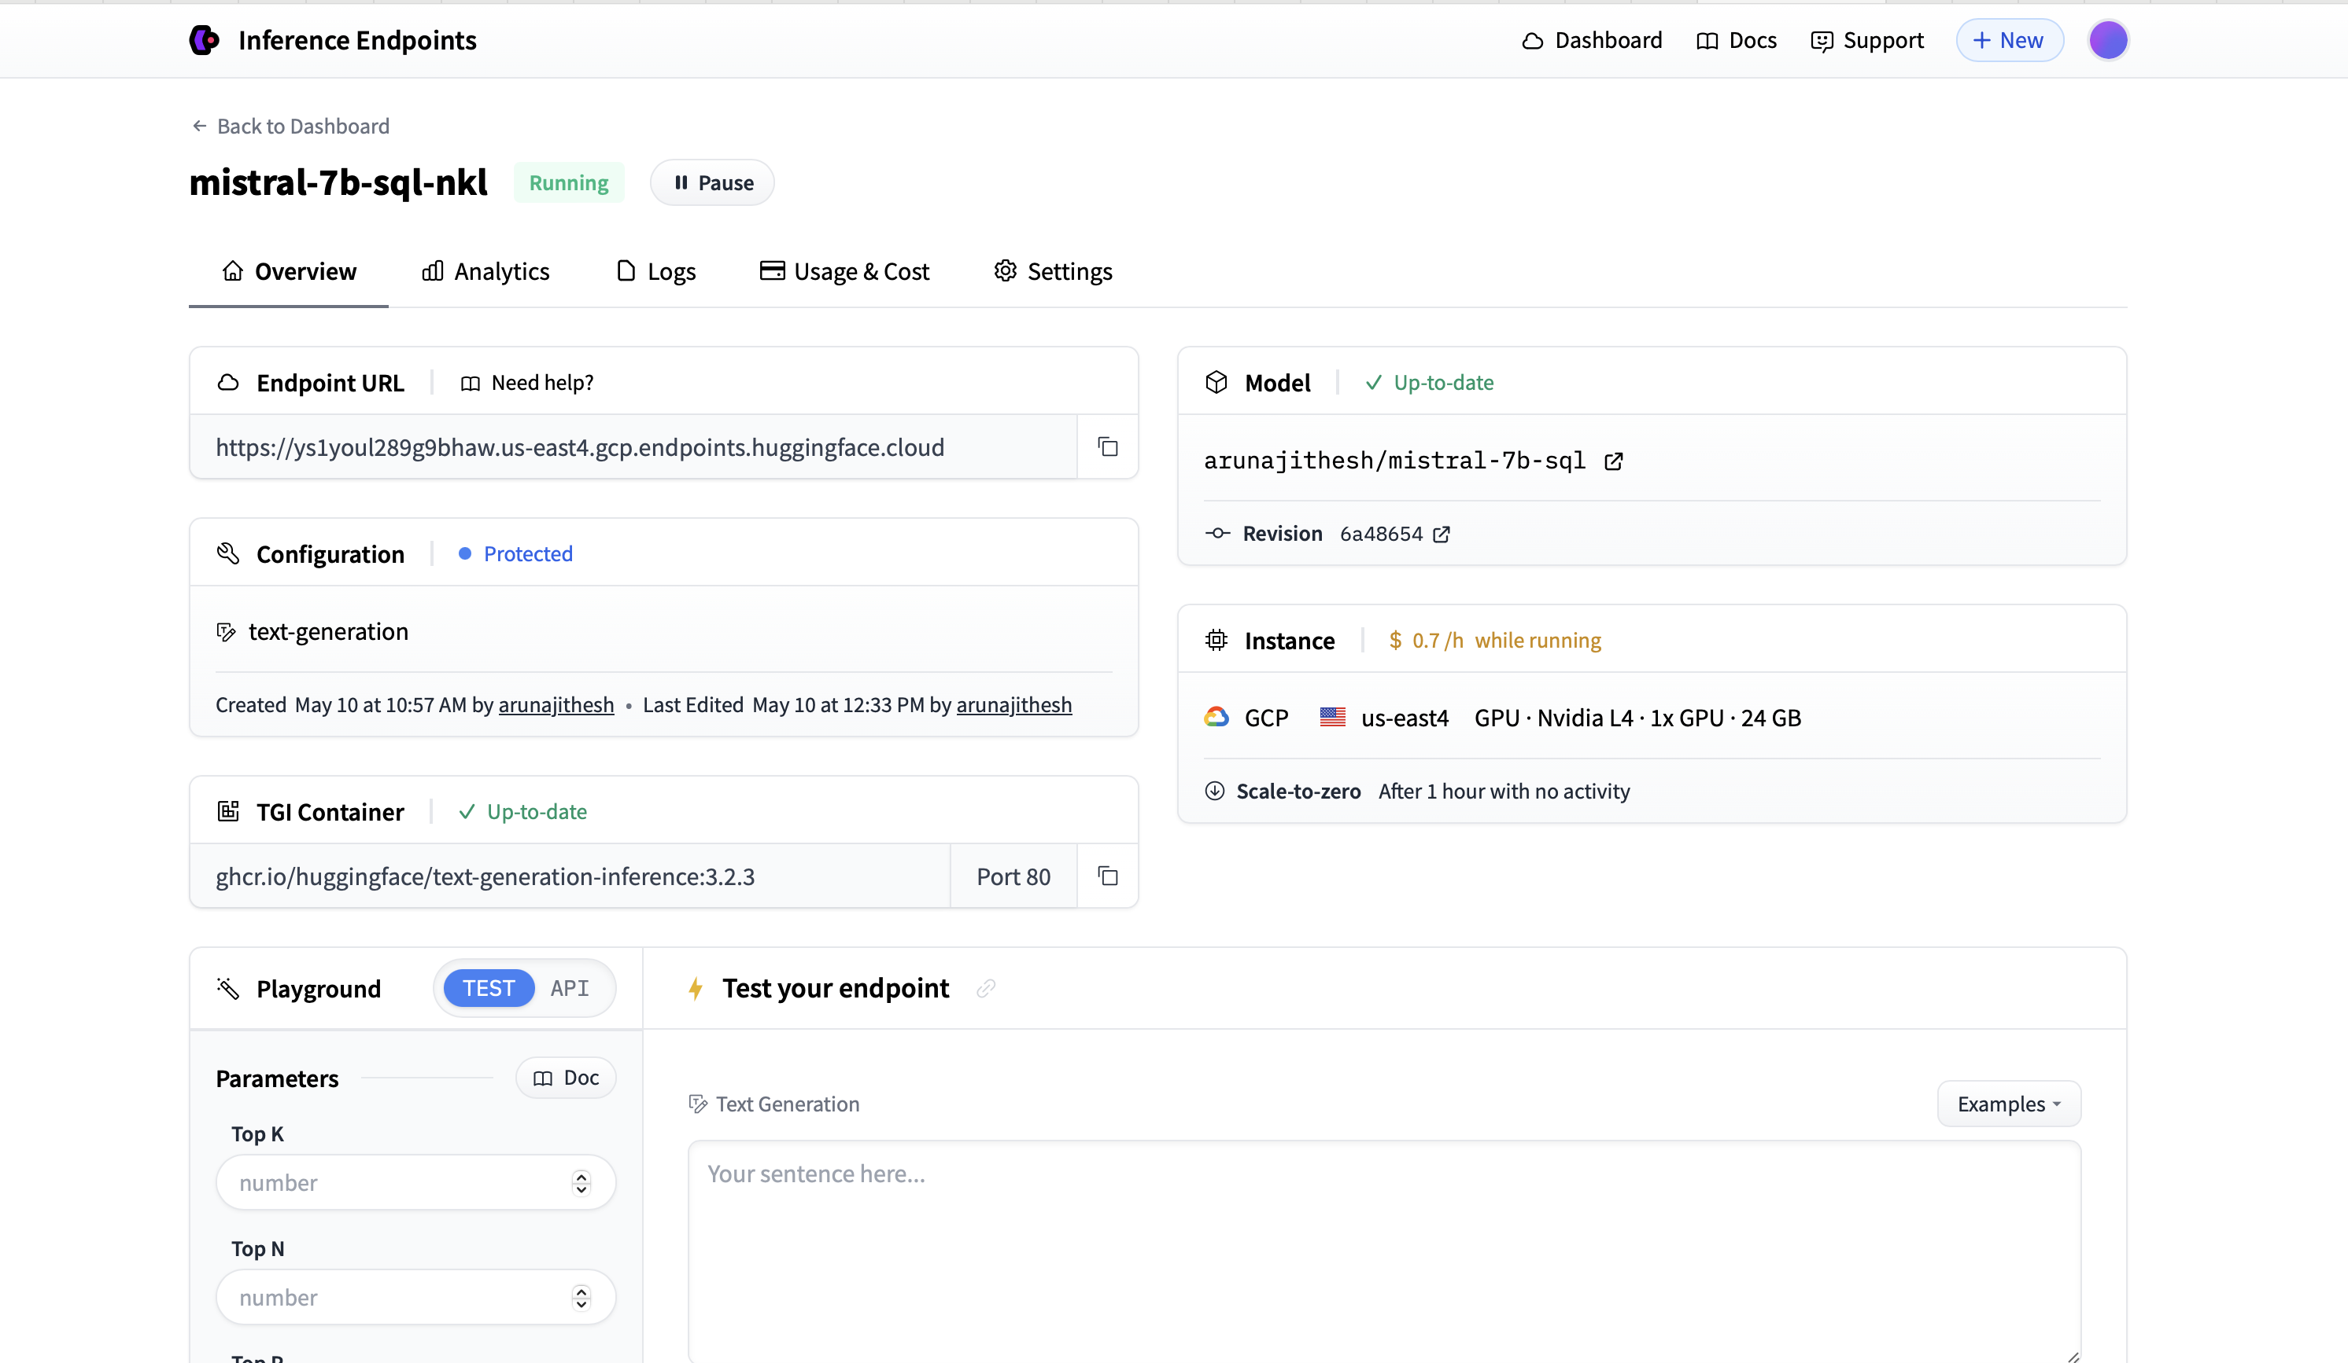
HUGGING FACE MODEL Deployment

Slide 20
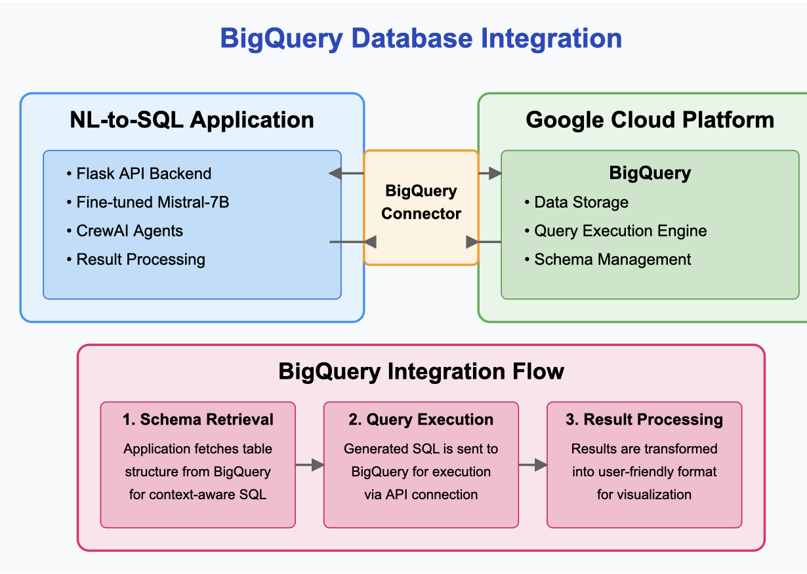
Big Query Integration
Architecture Components
NL-to-SQL Application
Flask API for user interactions and processing
Fine-tuned Mistral-7B model for SQL generation
Crew AI agents for query enhancement
Big Query Connector
Secure API connection with authentication
Schema information caching for performance
Google Cloud Platform
Big Query data warehouse solution
High-performance query execution engine
Integration Flow
Schema Retrieval: Application fetches table structure as context for SQL generation
Query Execution: Validated SQL is sent to Big Query for processing
Result Processing: Query results transformed into visualizations for users

Slide 21
Results & Impact
Query Accuracy:80% exact match on test queries
100% execution accuracy (queries that produce correct results)
92% component-wise accuracy across SQL elements
Development Efficiency:75% reduction in SQL development time
Average query development time reduced from 15 minutes to 3.5 minutes
82% decrease in SQL syntax errors reported
Accessibility Improvements: Enabled non-technical users to perform database queries
Reduced backlog of data analysis requests by 68%
Increased data exploration activity by 3.2x
Technical Performance: Average query generation time: 2.76 seconds (33% faster than base model)
Model size: 13.49 GB (same as original model)
Support for concurrent users via A100 GPU hosting
Business Impact: Democratized data access across the organization
Reduced dependency on specialized SQL developers
Accelerated data-driven decision making
Enabled self-service analytics for business teams

Slide 22
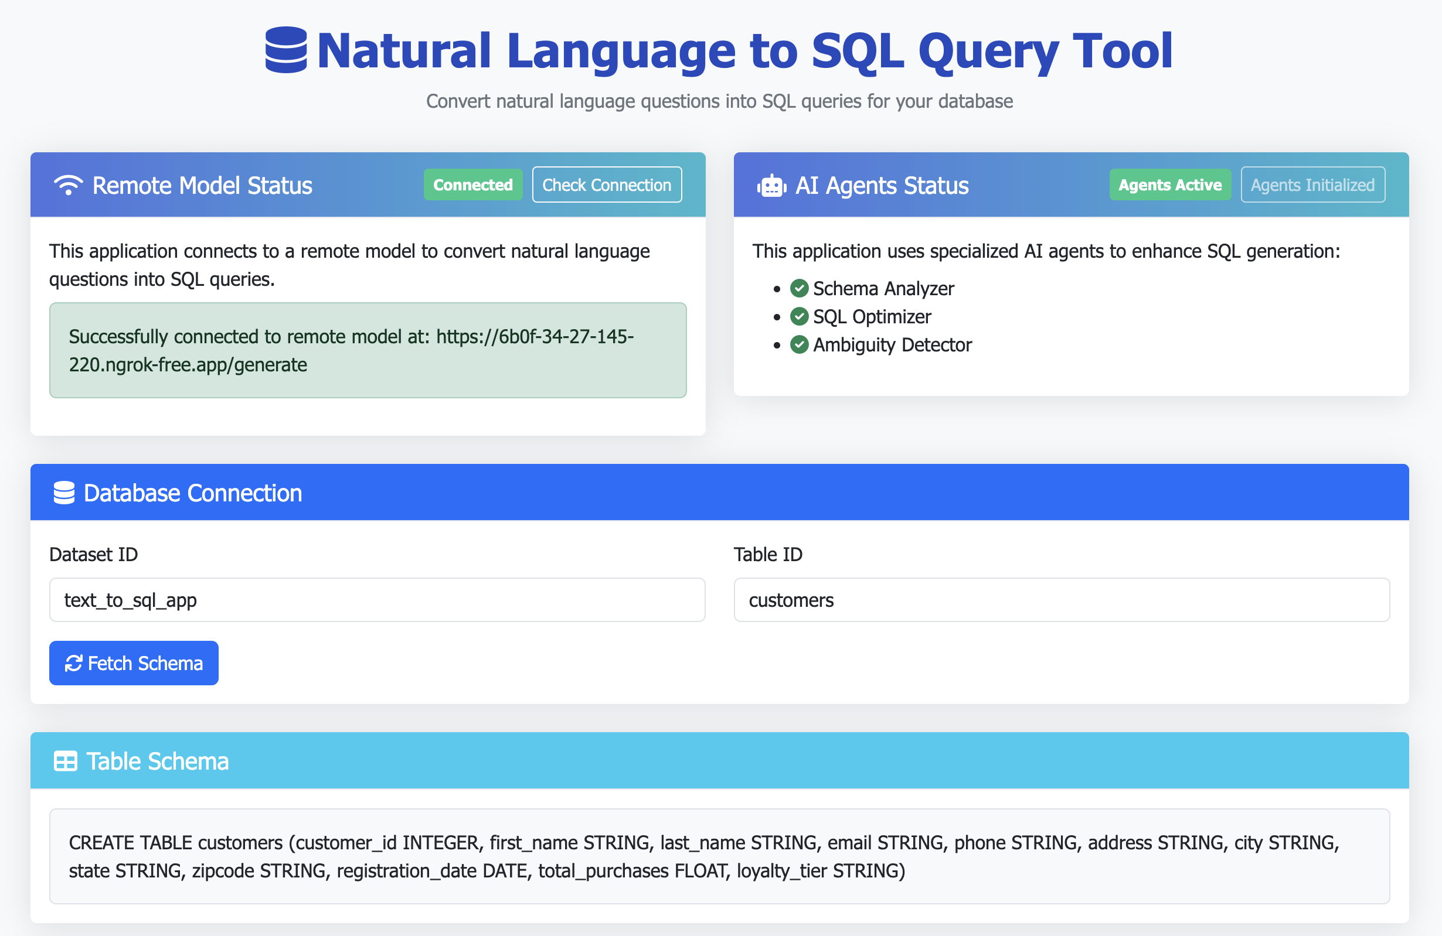
DEMO

Slide 23
Conclusion: Transforming Database Access Through Natural Language
Technical Achievement: Successfully fine-tuned Mistral-7B using Parameter-Efficient Fine-Tuning (PEFT) with dramatic performance improvements:
80% exact match accuracy (from 0%)
85% execution accuracy (from 54%)
92% component accuracy (from 7%)
Architecture Innovation: Created a robust system combining Flask, fine-tuned language models, Crew AI agents, and Big Query integration to enable seamless natural language database access.
User Empowerment: Transformed database interaction by enabling non-technical users to query complex data systems through natural language, democratizing data access across organizations.
Future Directions: As we continue development, we plan to expand language support, incorporate more complex query types, and further reduce latency while increasing accuracy through enhanced training methods.

Slide 24

Thank You!

